Slide 1
Team 2 Progress
Haruna Tanaka, Nicholas Mehr, Toshinori Kitamura,
Xiaobai Sun, Masayuki Takeda, Kai Ru

Slide 2
Goals
Applying mutual information based metrics (ex. “Towards a Deep and Unified Understanding of Deep Neural Models in NLP”) to convolutional character models for unsupervised morphological segmentation
Design:
Use convolutions with a kernel size of 2 so any subword can be captured by the perceptual field of a node
Estimate the “importance” of all nodes in all feature maps in convolution layers to derive segments that should correspond to semantically/syntactically meaningful parts (i.e. morphology)
Ideally, try out other approaches (ex. Learning Representation by Maximizing Mutual Information Across Views) and compare with baselines

Slide 3
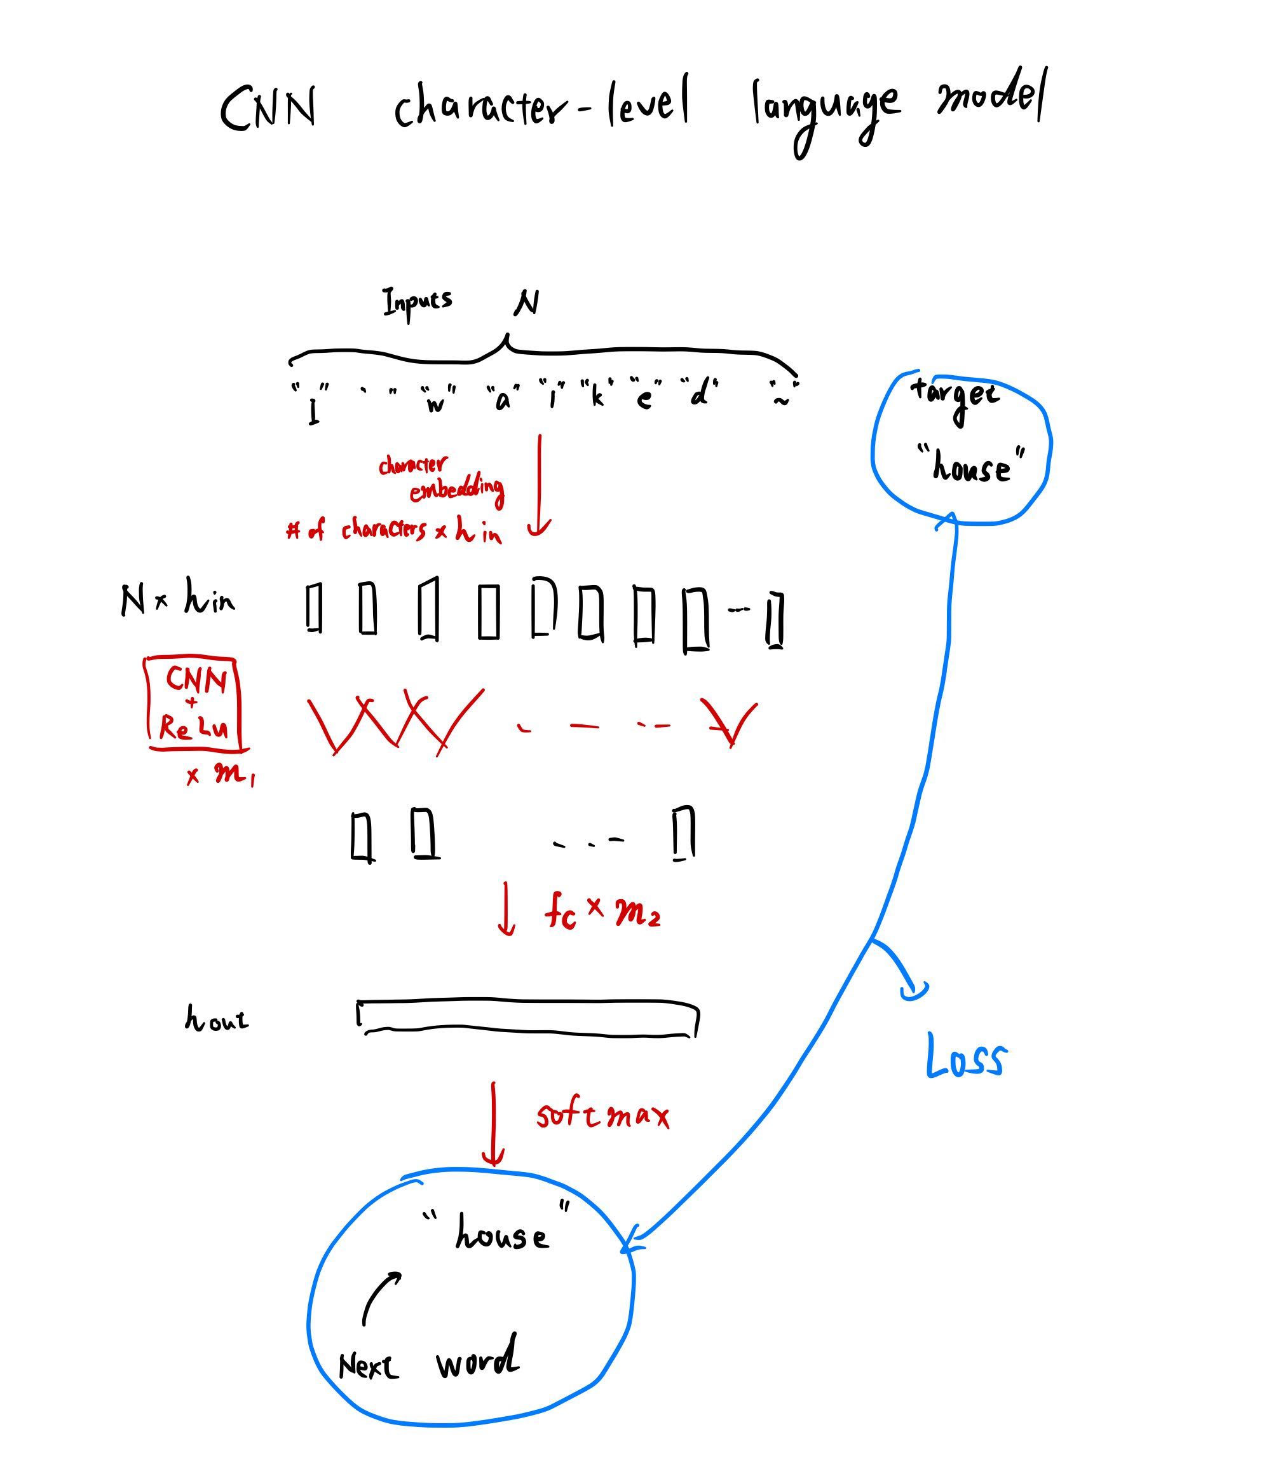

Slide 4
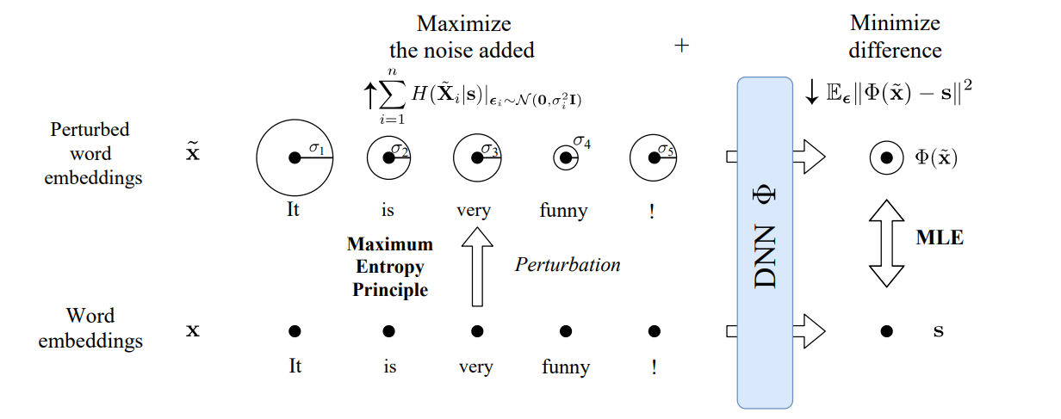
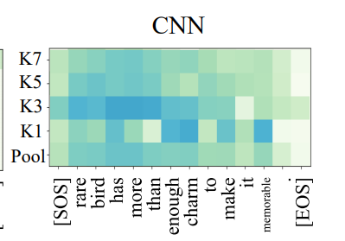
Towards a Deep and Unified Understanding of Deep Neural Models in NLP
Apply this to each layer

Slide 5
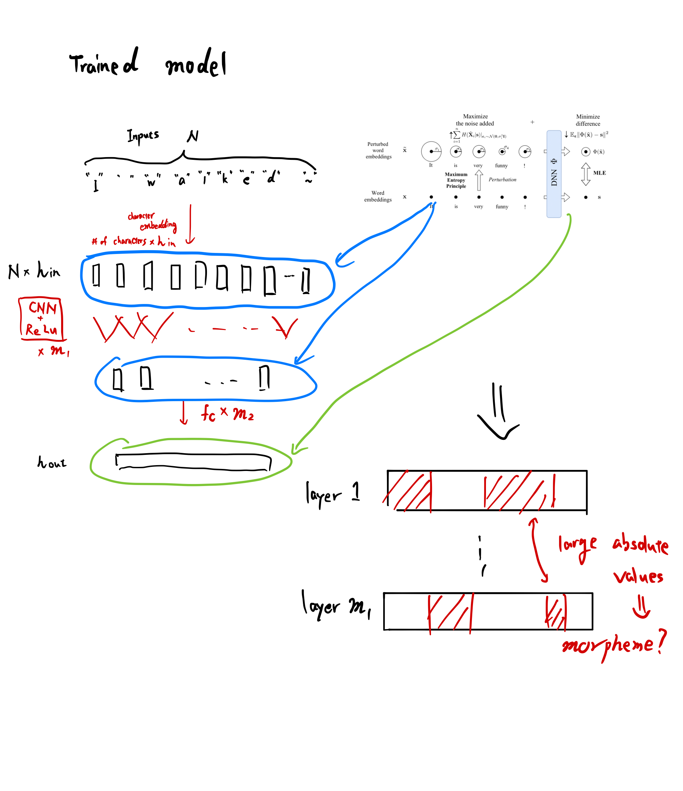

Slide 6
Challenges
Metrics such as mutual information intuitively seem valid for comparison between nodes in the same layer, but don’t make sense across layers
Given some metric of the relevance of nodes across feature maps, how to fairly score nodes in order to segment character strings?
Time: two of us are extremely busy right now writing our bachelor theses

